Slide 1



Hardware and Software Fundamentals of Intelligent Computing Systems
Notes:
需要涉及的要点：
- 第一课时：Compute Architectures 的逐渐演化：由AI/ML workload 引导，逐渐展示出多种多样的架构，如华为达芬奇、AMD等等
- 第二课时：互联的硬件基础，与CUDA core、Tensor core 的编程。
- 可能还需要涉及的点：课程整体设计（Syllabus、各个模块的内容，根据教学大纲生成了个overview的图）

Slide 2
Lecture 06: Vector Computation Basics Vector Add in Triton
Understanding the GPU Kernel Execution Model and Triton Programming Model

Slide 3
Starting with Vector Add
1
Parallel Task Partitioning
Decompose large-scale vector addition into multiple independent subtasks, each processing a portion of the data
Vector addition
2
Global Memory Access
GPU the most classic introductory GPU programming operator, where each element's computation is independent
Understand GPU global memory read/write patterns and optimize memory access efficiency
3
Bounds Control
c[i] = a[i] + b[i]
Handle data block boundary cases to ensure safe program execution
For each index i, add the corresponding elements of arrays A and B , storing results in array C
Notes:
单击此处添加文本

Slide 4
What is Triton?
→
Python DSL
High-Performance Kernel
OpenAI Open Source
Auto-generate Kernels
A GPU programming language developed by OpenAI, using a Python-style Domain Specific Language (DSL)
Compiler automatically converts Python code into high-performance GPU kernels — no handwritten CUDA required
Applied to
Design Goals
Performance close to CUDA，Development cost close to PyTorch
Kernel
Deep Learning
PyTorch
Notes:
单击此处添加文本

Slide 5
Triton Execution Model
Triton basic execution unit program, multiple programs form a grid, each program handles one data block
CUDA Concept | ⇄ | Triton Concept
thread block | = | program
blockIdx | = | program_id
gridDim | = | launch grid
Key Insight:Triton's program corresponds to CUDA's thread block, but Triton operates on data in a vectorized manner rather than per-thread
Notes:
图片来源：Triton 官方文档

Slide 6
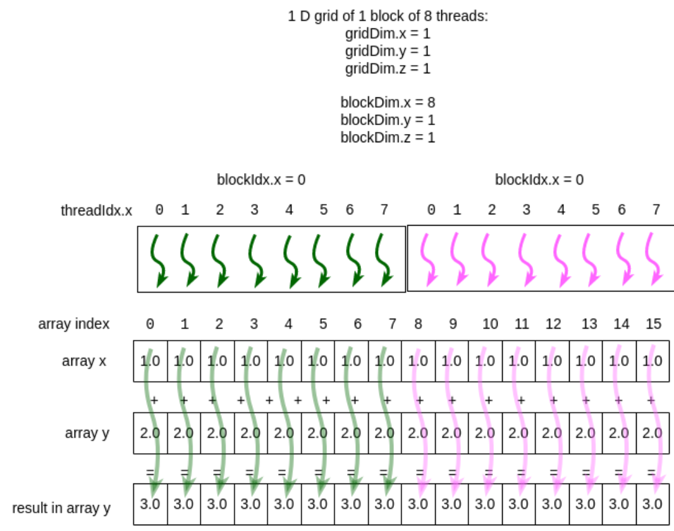
Vector Add Problem Definition
c[i] = a[i] + b[i]
Element-wise addition of two vectors, storing results in a third vector
Goals
•
Parallel computation: fully leverage GPU parallel capabilities
•
Block processing: each program handles BLOCK_SIZE elements
Parallel Strategy
1
Divide the vector into multiple data blocks
2
Each program handles one block
3
Elements within a block computed in parallel
Image source: https://www.learnpdc.org/PDCBeginners/4-cuda/6-VectorAddTiming.html
Notes:
图片来源：向量加法并行计算示意图

Slide 7
Official Kernel Example
@triton.jit def add_kernel(x_ptr, y_ptr, output_ptr, n_elements,
BLOCK_SIZE: tl.constexpr):
# Get the ID of the current program
pid = tl.program_id(axis=0)
# Calculate the starting position of the current block
block_start = pid * BLOCK_SIZE
# Generate local offset array [0, 1, 2, ..., BLOCK_SIZE-1]
offsets = block_start + tl.arange(0, BLOCK_SIZE)
# Create mask to prevent out-of-bounds access
mask = offsets < n_elements
# Load data from global memory
x = tl.load(x_ptr + offsets, mask=mask)
y = tl.load(y_ptr + offsets, mask=mask)
# Perform vector addition
output = x + y
# Write results back to global memory
tl.store(output_ptr + offsets, output, mask=mask)
Source: Triton Official Tutorial https://triton-lang.org/main/getting-started/tutorials/01-vector-add.html
Notes:
单击此处添加文本

Slide 8
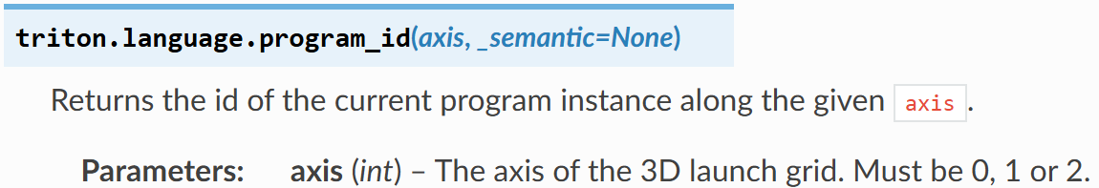
program_id
Program distribution in the Grid
0
Handles data block 0
1
Handles data block 1
pid = tl.program_id(axis=0)
2
Handles data block 2
Returns the index of the current program in dimension 0 of the grid
...
Similar to CUDA's blockIdx.x
N
Handles data block N
Used to determine which data block the current program should handle
Image source: Triton Official Docs https://triton-lang.org/main/python-api/generated/triton.language.program_id.html
Notes:
单击此处添加文本

Slide 9
Offset Calculation Method
# Calculate the starting position of the current block
block_start = pid * BLOCK_SIZE
# Generate global offsets
offsets = block_start + tl.arange(0, BLOCK_SIZE)
1
Each program handles BLOCK_SIZE consecutive elements
2
tl.arange Generates local indices [0, 1, ..., BLOCK_SIZE-1]
3
Adding block_start to get global indices
Calculation Example (BLOCK_SIZE = 256)
program_id = 0
program_id = 1
program_id = 2
block_start = 0
offsets = [0..255]
block_start = 256
offsets = [256..511]
block_start = 512
offsets = [512..767]
Handles elements 0–255
Handles elements 256–511
Handles elements 512–767
Notes:
单击此处添加文本

Slide 10
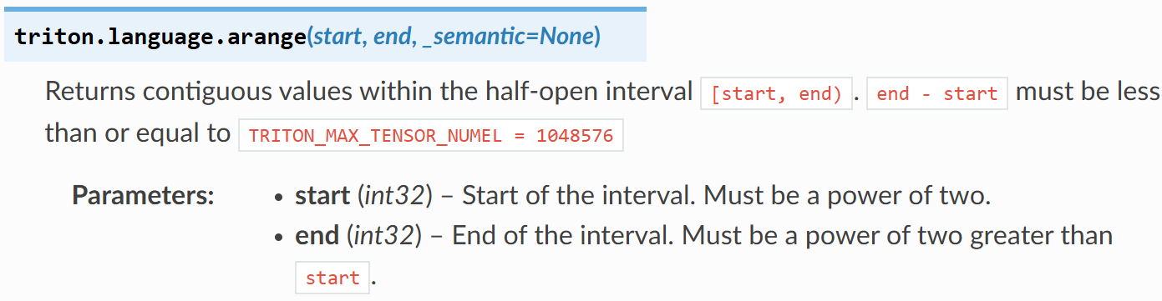
tl.arange
Vector vs Scalar Operation Comparison
CUDA (Scalar Operations)
// Each thread handles one elementint idx = blockIdx.x * blockDim.x
+ threadIdx.x;
float x = input[idx];
float y = x * 2.0;
output[idx] = y;
tl.arange(0, BLOCK_SIZE)
Each thread handles one scalar value
Generates vector indices
Triton (Vector Operations)
Generates a contiguous integer array from start to end-1
# Each program handles one vector
offsets = block_start + tl.arange(0, BLOCK)
x = tl.load(ptr + offsets)
y = x * 2.0
tl.store(out_ptr + offsets, y)
Tensor Operations
Triton operates on tensor, not individual threads
Each program handles one vector (multiple elements)
Notes:
单击此处添加文本

Slide 11
mask Role
When offsets ≥ n_elements
mask = offsets < n_elements
• load does not access memory
• store does not write to memory
Core Role
When offsets < n_elements
Prevent the last block from going out of boundsaccessing memory
• load reads data normally
• store writes results normally
# Create mask
mask = offsets < n_elements
# load operation with mask
x = tl.load(x_ptr + offsets, mask=mask)
y = tl.load(y_ptr + offsets, mask=mask)
# Compute
output = x + y
# store operation with mask
tl.store(output_ptr + offsets, output, mask=mask)
mask Usage Example
Notes:
单击此处添加文本

Slide 12
mask How It WorksExample
Assumed Conditions
n_elements = 1000
BLOCK_SIZE = 1024
Vector has 1000 elements, but each block processes 1024 — the last block exceeds the boundary
Last block (program_id = 0, only one block)
offsets array
mask array
0
1
2
...
998
999
1000
...
T
T
T
...
T
T
F
...
Index range: [0 ... 1023]
True = access, False = skip
Result:Only positions where offsets < 1000 are accessed; out-of-bounds positions are protected by the mask
Notes:
单击此处添加文本

Slide 13
tl.load Details
Supports mask: conditional read, prevents out-of-bounds
x = tl.load(
x_ptr + offsets,
mask=mask
)
Vectorized read: reads multiple elements at once
Returns tensor: enables direct vectorized computation
Full Parameter Description
tl.load(ptr, mask=None, other=None, cache_modifier="", eviction_policy="", volatile=False)
ptr
mask
Data pointer, can be a single address or array of addresses
Boolean array controlling which positions to read
other
cache_modifier
Default value when mask is False
Cache modifier (e.g., ".ca", ".cg")
Notes:
图片来源：Triton 官方文档 https://triton-lang.org/main/python-api/generated/triton.language.load.html

Slide 14
tl.store Details
Supports mask: conditional write, prevents out-of-bounds
tl.store(
output_ptr + offsets,
output,
mask=mask
)
Conditional write: only writes to positions where mask is True
Guarantees memory safety: avoids illegal memory writes
Full Parameter Description
tl.store(ptr, value, mask=None, cache_modifier="", eviction_policy="")
ptr
value
mask
Target memory address
Data to write (tensor)
Controls write positions
store operation must include mask, otherwise it may cause out-of-bounds memory access and data corruption
Notes:
图片来源：Triton 官方文档 https://triton-lang.org/main/python-api/generated/triton.language.store.html

Slide 15
Grid Definition
# Define grid
grid = lambda meta: (
triton.cdiv(n_elements, meta['BLOCK_SIZE']),
)
# Launch kernel
add_kernel[grid](...)
grid is a tuple
Represents a 1D, 2D, or 3D grid
Grid Size Calculation
Size = ceil(n_elements / BLOCK_SIZE)
1D grid
This example uses a 1D grid with only one dimension
Calculation Example
Example 1
Example 2
n_elements = 10000
BLOCK_SIZE = 1024
n_elements = 5000
BLOCK_SIZE = 256
grid = (10,)
ceil(10000/1024) = 10
grid = (20,)
ceil(5000/256) = 20
Notes:
单击此处添加文本

Slide 16
Why Use lambda meta?
# lambda meta syntax
grid = lambda meta: (
triton.cdiv(n_elements,
meta['BLOCK_SIZE']),
)
# triton.cdiv function
triton.cdiv(a, b) = ceil(a / b)
# Example
triton.cdiv(1000, 256) = 4# ceil(1000/256) = ceil(3.906) = 4
Core Problem
BLOCK_SIZE is a constexpr(compile-time constant), and grid must be computed dynamically from meta
Solution
Use a lambda function to defer computation and retrieve the actual BLOCK_SIZE value at kernel compile time
Execution Flow
1
2
3
→
→
Define kernel
Specify BLOCK_SIZE
lambda retrieves
meta['BLOCK_SIZE']
Compute grid
Launch kernel
Image source: Triton Official Docs
Notes:
单击此处添加文本

Slide 17
[] Syntax
add_kernel[grid](
x_ptr, y_ptr,
output_ptr, n_elements
)
__getitem__ Override
Triton overrides Python's __getitem__ method
kernel[grid]
Specifies the launch grid, determines number of programs
(...) Execute
Pass arguments to actually execute the kernel
Syntax Breakdown
kernel object
[
grid config
]
(
function args
)
add_kernel
grid
...
Equivalent to: add_kernel.__getitem__(grid).__call__(...)
Notes:
单击此处添加文本

Slide 18
Triton vs CUDA Comparison
CUDA
Triton
// Compute global thread indexint idx = blockIdx.x * blockDim.x
+ threadIdx.x;
// Bounds checkif (idx < n_elements) {
float x = input[idx];
output[idx] = x * 2.0;
}
# Get program ID
pid = tl.program_id(0)
# Compute offsets (vectorized)
offsets = pid * BLOCK_SIZE \
+ tl.arange(0, BLOCK_SIZE)
# Memory operations with mask
mask = offsets < n_elements
x = tl.load(ptr + offsets, mask=mask)
• Requires manual management of thread, block, grid
• Each thread handles one element
• Program-level abstraction, auto-managed
• Requires explicit bounds checking
• Vectorized operations, processes multiple elements at once
• mask mechanism simplifies bounds handling
Notes:
单击此处添加文本

Slide 19
Official Benchmark
Triton Performance Advantages
Performance Comparison
Performance close to CUDA
CUDA
100%
Achieves handwritten CUDA performance levels through automatic optimization
High Development Efficiency
Triton
95-100%
Concise Python syntax significantly reduces development cost
Automatic Optimization
PyTorch (eager)
60-80%
Compiler automatically performs memory access optimization, vectorization, and more
Reference
The bottom of the official Triton tutorial page provides detailed performance comparison charts for various operators across different hardware
https://triton-lang.org/main/getting-started/tutorials/01-vector-add.html
Notes:
单击此处添加文本

Slide 20
Vector Add Workflow
program_id
Get the current program ID
Compute block start
block_start = pid * BLOCK_SIZE
Generate offsets
offsets = block_start + tl.arange(0, BLOCK_SIZE)
mask prevents out-of-bounds
mask = offsets < n_elements
load
x = tl.load(x_ptr + offsets, mask=mask)
Notes:
单击此处添加文本

Slide 21
Core Concepts: Summary
program
program_id
grid
BLOCK_SIZE
Triton's basic execution unit, corresponds to CUDA's thread block
Index of the current program in the grid, similar to blockIdx.x
Collection of programs defining the scale of parallel execution
Number of elements each program handles, a compile-time constant
tl.arange
mask
tl.load
tl.store
Generates vector indices for vectorized operations
Boolean array controlling memory access and preventing out-of-bounds
Reads data from global memory, supports mask and vectorization
Writes data to global memory, supports mask protection
Notes:
单击此处添加文本

Slide 22

The Solution: FlagOS, a Unified AI Software Stack

Slide 23








https://space.bilibili.com/3546791834290849
https://github.com/flagos-ai
https://www.zhihu.com/people/95-22-20-18/posts
https://flagos.io/Home

Slide 24

Thanks for your time！

